Slide 1

Lesson 1 — Introduction to Artificial Intelligence and Machine Learning
Lesson 1: Concepts, Terminology and Learning Approaches

Slide 2
Learning Objectives
Distinguish artificial intelligence, machine learning and deep learning.
Explain the main terminology used in a machine learning project.
Distinguish supervised, unsupervised and reinforcement learning.
Recognise regression, classification, clustering and dimensionality reduction.
Identify common algorithms and the tasks they address.
Formulate a climate problem as a machine learning task.

Slide 3
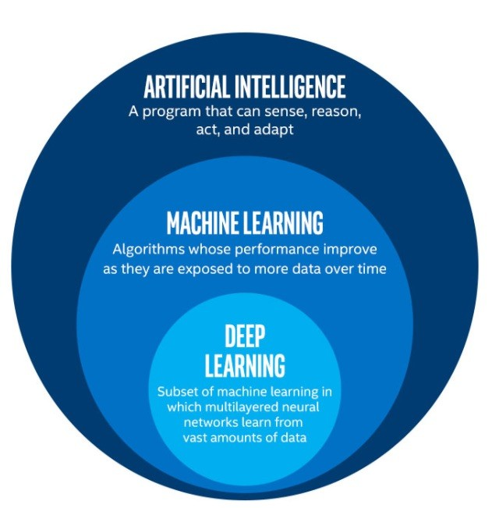
Artificial Intelligence, Machine Learning and Deep Learning
Artificial intelligence — AI
  The broad field of building computational systems that perform tasks involving capabilities such as perception, reasoning, language understanding, planning and decision-making.
Machine learning — ML
  A family of AI methods that learns patterns or relationships from data to perform a task.
Deep learning — DL
  A family of machine learning methods based on neural networks with multiple processing layers that learn representations of data.

Slide 4
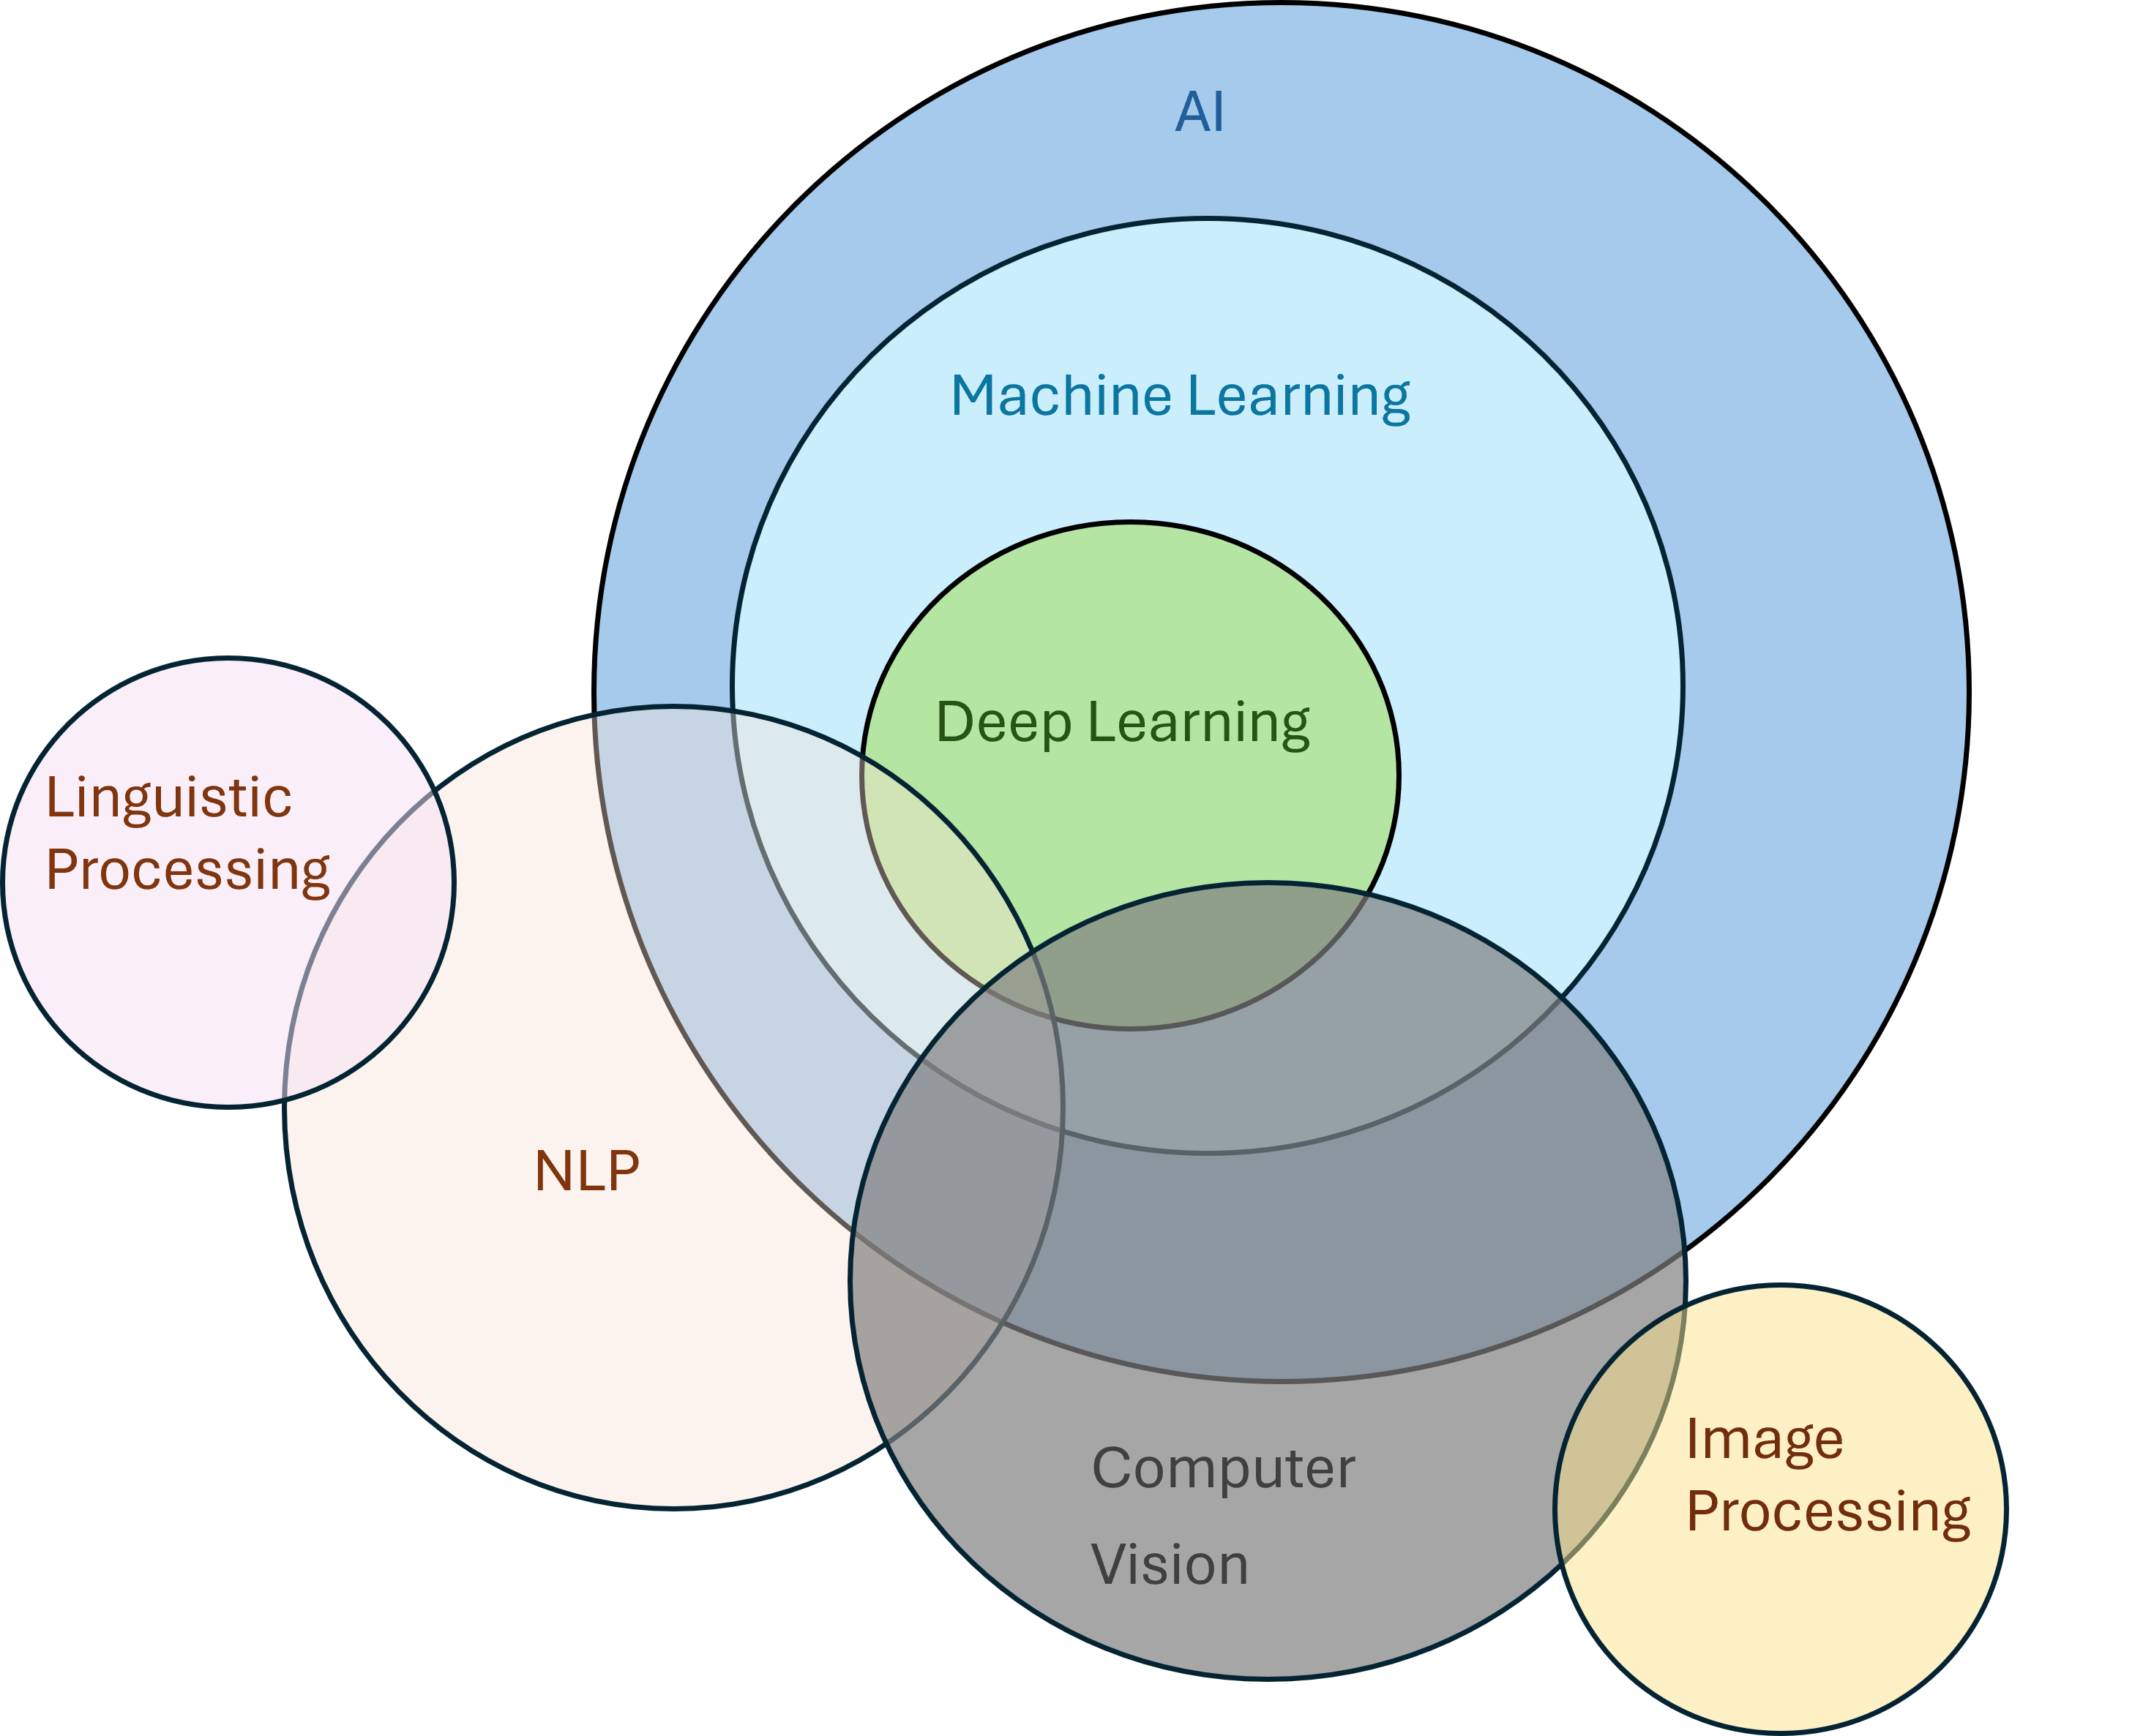
Data Science and Related Fields
Concept | Main purpose | Climate example
Data science | Extract knowledge and useful results from data using statistics, computing and domain knowledge | Analyse rainfall records and communicate trends
Machine learning | Learn relationships or structure from examples | Predict solar generation
Computer vision | Extract information from images and video | Identify land-cover classes in satellite imagery
Natural language processing | Process and analyse human language | Extract information from environmental reports
Generative AI | Generate content such as text, images or other data | Draft explanations of verified climate indicators

Slide 5
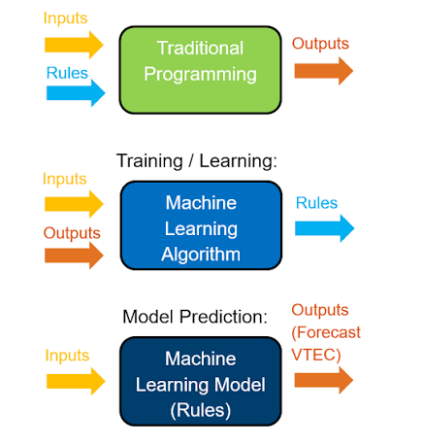
Explicit Rules and Learning from Data
A person writes the decision logic.
If soil moisture is below a chosen threshold:
Flag the reading for attention
Machine learning approach
  A model learns a relationship from examples.
  Inputs: soil moisture, temperature, crop stage
  Target: measured water requirement
  Output: estimated water requirement for a new example
Technical distinction
A rule-based system uses logic specified by its designer.
A learned model estimates parameters or decision structures from data.
A practical system can combine both approaches.

Slide 6
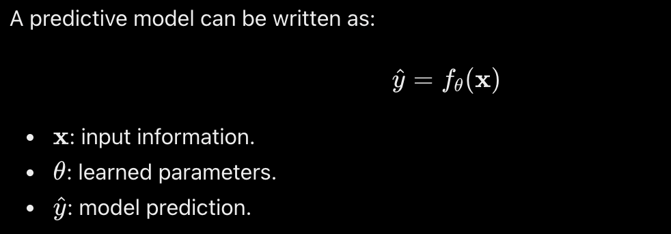
What Does “Learning” Mean?
A model uses examples to improve performance on a defined task.
Element | Meaning | Example
Task | What the system should do | Predict next-day solar generation
Experience | The data available for learning | Historical weather and generation records
Performance measure | How we judge success | Prediction error in kWh
A predictive model can be written as:
Learning means adjusting the model using data.

Slide 7
The Structure of a Machine Learning Dataset
Example: predicting daily solar generation
Observation | Solar radiation | Temperature | Installed capacity | Energy generated
Site A, day 1 | Input measurement | Input measurement | Site attribute | Target measurement
Site A, day 2 | Input measurement | Input measurement | Site attribute | Target measurement
Site B, day 1 | Input measurement | Input measurement | Site attribute | Target measurement
Terminology
Dataset: the collection of examples.
Sample / instance / observation: one example.
Feature: an input variable.
Target: the quantity or category we want to predict.
Label: the target value attached to a training example, especially in classification.
Metadata: information describing the records, such as source or collection method.

Slide 8
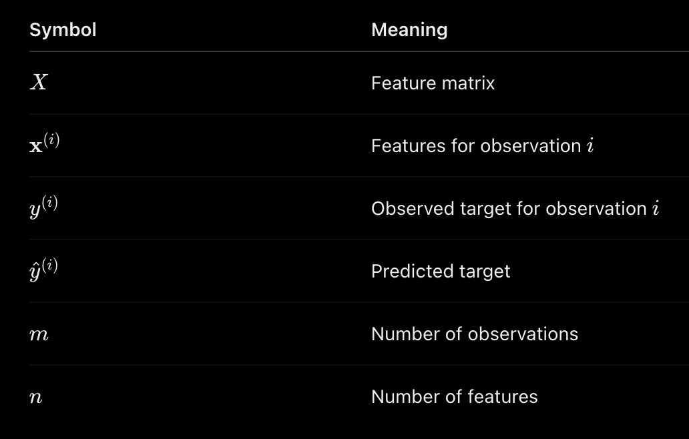

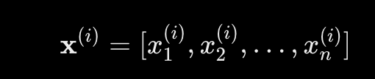
Features, Targets and Mathematical Notation
For m observations and n features:
Each row represents an observation. Each column represents a numerical feature after any required encoding.

Slide 9
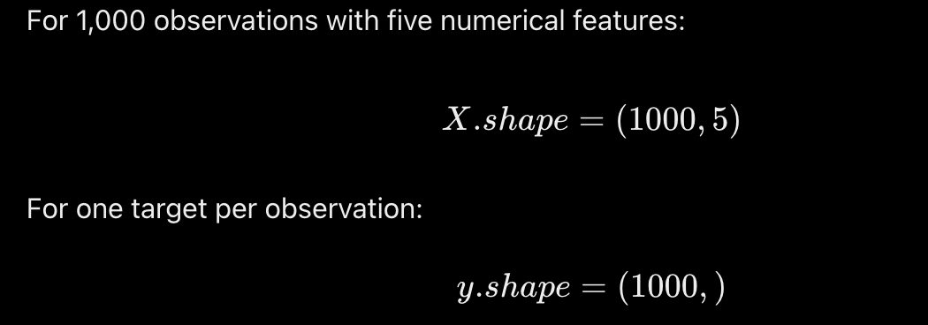
Example

Slide 10
Model, Algorithm, Parameters and Hyperparameters
Term | Definition | Example
Model | The mathematical structure used to produce outputs | A linear prediction function
Learning algorithm | The procedure that fits a model using data | A decision-tree training procedure
Parameter | A value learned during fitting | A regression coefficient
Hyperparameter | A setting chosen outside parameter fitting | Maximum tree depth
Training / fitting | The process of learning from training data | Estimating coefficients
Inference | Applying a fitted model to new inputs | Producing a temperature prediction

Slide 11
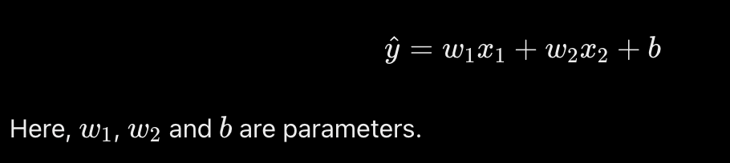
Example model

Slide 12
The Main Learning Approaches
Approach | Learning information | Main objective | Climate example
Supervised learning | Inputs paired with targets | Learn to predict a target | Predict measured energy generation
Unsupervised learning | Inputs without task-specific target labels | Discover structure or useful representations | Group locations by seasonal climate profiles
Reinforcement learning | Interactions, actions and rewards | Learn a policy for sequential decisions | Optimise battery operation in a simulator
Two additional approaches
Semi-supervised learning: combines a limited labelled dataset with additional unlabelled data.
Self-supervised learning: creates learning targets from the data itself, such as predicting masked parts of an input.

Slide 13
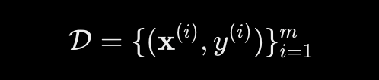
Supervised Learning
A supervised dataset contains input–target pairs:
Training process
Provide examples with known targets.
Generate model predictions.
Measure the disagreement between predictions and targets.
Adjust the model according to its training procedure.
Evaluate performance on separate examples.
Two major task types
Regression: predict a numerical quantity.
Classification: predict membership in a category.
Climate applications
Temperature estimation, energy forecasting, land-cover classification and event detection.

Slide 14
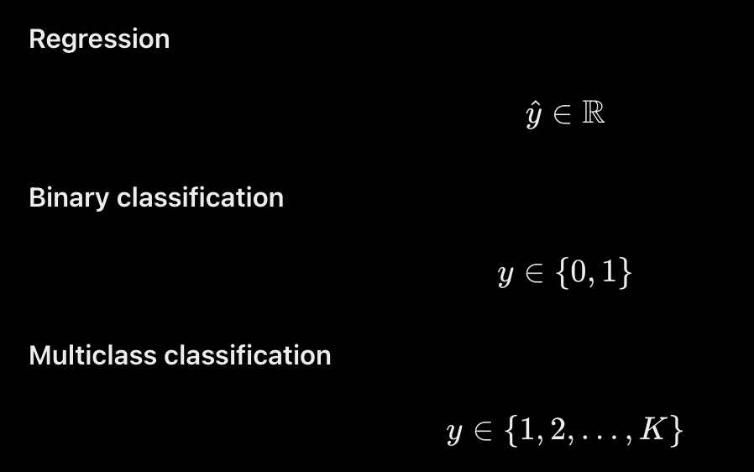
Regression and Classification
Aspect | Regression | Classification
Target | Numerical quantity | Category
Example | Daily energy generation | Land-cover class
Possible output | 145.7 kWh | Cropland
Common evaluation measures | MAE, RMSE | Precision, recall, F1, accuracy
A classifier may output class scores or probabilities before applying a decision rule.

Slide 15
Common Supervised Learning Techniques
Technique | Common tasks | Core idea | Important consideration
Linear regression | Regression | Fit a weighted combination of features | Limited by the chosen feature representation
Logistic regression | Classification | Model class probabilities using a transformed linear score | Despite its name, commonly used for classification
k-nearest neighbours | Both | Use nearby training examples | Sensitive to feature scaling and distance choice
Decision trees | Both | Learn a sequence of feature-based splits | Deep trees can overfit
Random forests | Both | Combine many randomised decision trees | Less straightforward to interpret than one tree
Gradient-boosted trees | Both | Add trees sequentially to improve an objective | Require careful control of model complexity
Support vector machines | Classification and regression variants | Use margins or tolerance regions, optionally with kernels | Scaling and parameter selection matter
Neural networks | Both | Learn compositions of transformations | Architecture, data and optimisation affect performance
Selection principle
Choose methods according to the task, data structure, evaluation results and practical constraints.

Slide 16

Unsupervised Learning
An unsupervised dataset provides inputs without target labels for the learning task:
Main objectives
Discover groups of similar observations.
Represent data using fewer dimensions.
Identify unusual patterns for investigation.
Climate example
Represent each location using:
Monthly temperature profile.
Monthly rainfall profile.
Seasonal variability.
Then investigate which locations have similar profiles.
Interpretation requirement
The algorithm finds structure according to its mathematical objective. Domain knowledge determines whether that structure is useful.

Slide 17
Common Unsupervised Learning Techniques
Technique | Typical purpose | Core idea | Important consideration
K-means | Clustering | Assign observations to \(K\) centroids to reduce within-cluster squared distances | Requires a choice of \(K\) and meaningful feature scales
Hierarchical clustering | Clustering | Build nested groups using a distance and linkage rule | Results depend on distance and linkage choices
DBSCAN | Clustering and noise identification | Find connected regions of sufficient density | Sensitive to density settings and varying densities
Principal component analysis — PCA | Dimensionality reduction | Find orthogonal directions of maximum variance | High variance does not necessarily mean high relevance
Isolation Forest | Anomaly detection | Identify observations that are easier to isolate through random partitions | An unusual record is not automatically an error or hazard

Slide 18
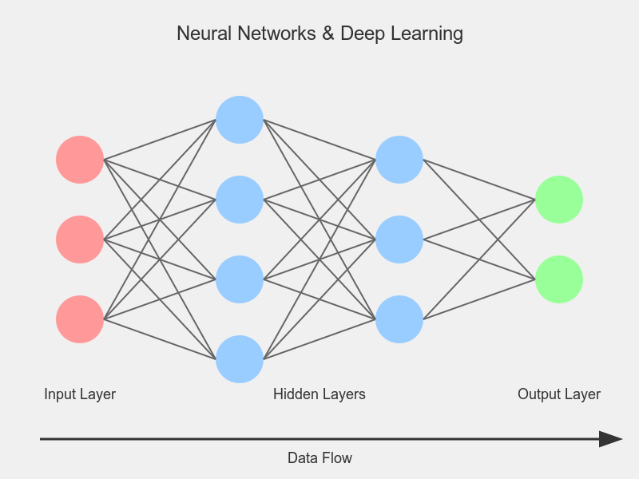
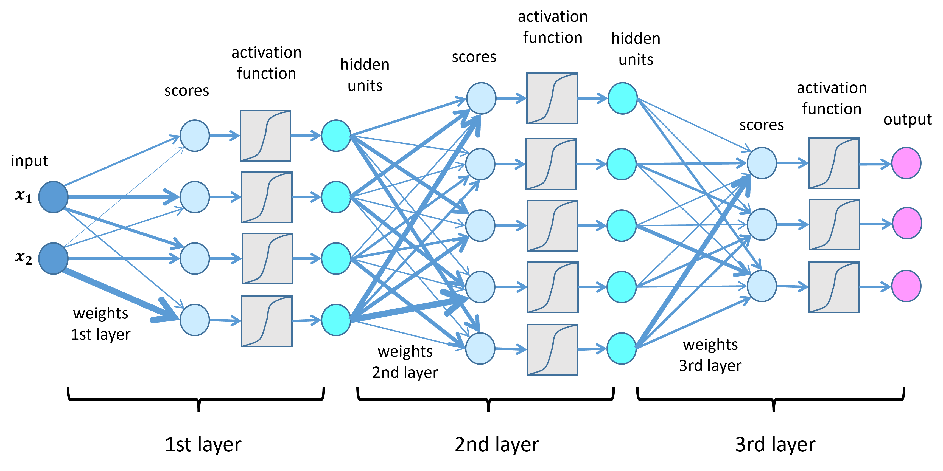
Deep Learning and Neural Networks

Slide 19
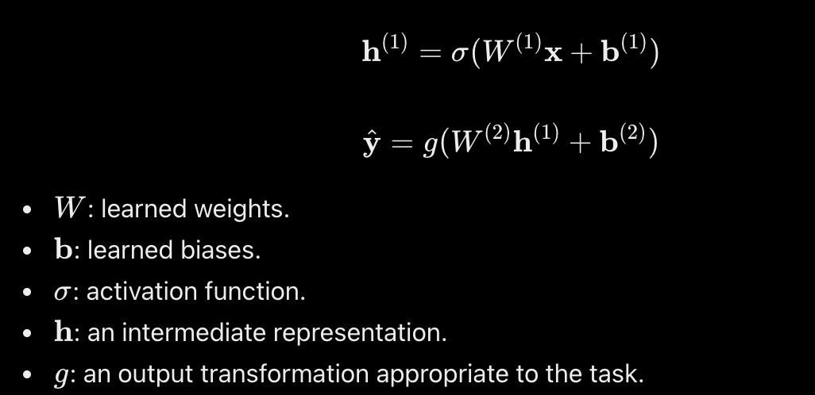
Deep Learning and Neural Networks
A neural network transforms an input through connected layers:
Architecture | Typical data or purpose
Multilayer perceptron | General numerical feature vectors
Convolutional neural network | Images and spatial patterns
Recurrent network, including LSTM | Sequential data
Transformer | Relationships within sequences and other structured inputs

Slide 20
Training, Evaluation and Generalisation
Generalisation: The ability of a fitted model to perform well on new examples relevant to its intended use.
Data partition | Purpose
Training set | Learn model parameters
Validation set | Compare approaches and choose settings
Test set | Evaluate the selected approach
Essential terminology
Loss: a numerical measure used to quantify prediction error during learning.
Metric: a measure used to report performance.
Underfitting: the model fails to capture important structure.
Overfitting: training performance does not transfer reliably to new data.
Data leakage: information enters the process that would not legitimately be available.

Slide 21
Defining an ML Problem for a Climate Product
Before selecting an algorithm, complete the following specification:
Question | Example answer
Who will use the output? | A solar-system operator
What decision could it support? | Planning battery charging
What does one example represent? | One site and one forecast-origin day
What inputs are available at that time? | Historical generation and available weather forecasts
What is the target? | Next-day energy generation
Which task is this? | Supervised regression
What is the baseline? | A simple historical or persistence forecast
How will we evaluate it? | Error on later dates, in kWh

Slide 22
Machine Learning Algorithms
Supervised learning
Unsupervised learning
Recommender system
Reinforcement learning
Notes:
We talk about Machine Learning. Lets look machine learning algorithms. First one is Supervised learning, other one is unsupervised learning. These are two main catagory of machine learning. During the 2-3 weeks we will cover the supervised learning. One week we will cover unsupervised learning , 1 week recommender system and 1 week reinforcement learning.
Supervised learning is most well known, useful and basic. Why it is most frequently using practical application.

Slide 23
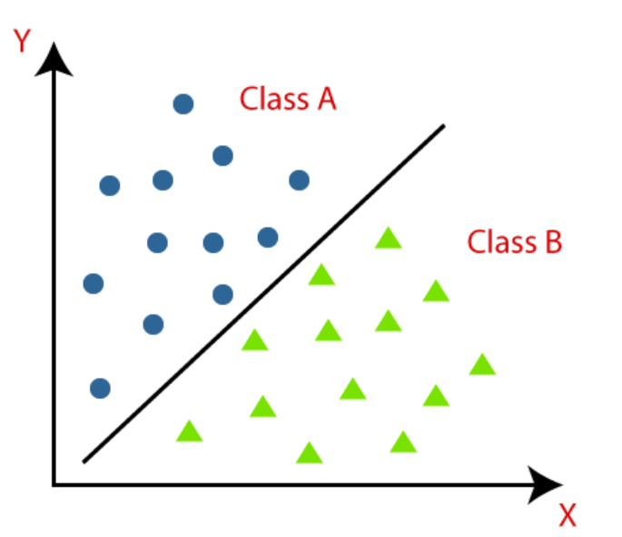
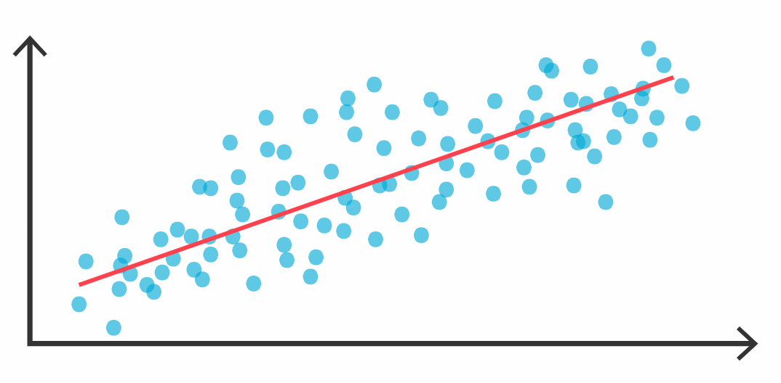
Supervised Learning
Regression
Classification
Notes:
Lets start with supervised learning. We have two type supervised learning regression and classification. You can see here right and you can get some intuinatiın looking by this Picture. Actually we will deep dive this concept later but if you check regression there is lots of data and we try to fit one line right according to this line fitted we are predicting new data. What about this classification image. There is Class A and class B but. According to this classes we obtained this line and when we have new point here as unseen data we will look if our data below of this line or not according to that we will predict. This is actually core concept of supervised learning. Lets look at more what is supervised learning.

Slide 24

Supervised Learning
Circle
Model
Prediction
Square
Labeled Data
Circle
Test Data
Triangle
Square
Lables
Notes:
Supervised learning is like teaching a kid with flashcards.
In the beginning, we give the computer something called labeled data — for example, lots of shapes like triangles, circles, and squares, and we tell the computer exactly what each shape is. So it starts learning from these examples, just like a student studying for a test.
This training data goes into something called a model — you can think of the model like a brain that’s trying to figure out the rules behind the shapes.
Once the model has learned enough, we give it new shapes it has never seen before — that’s the test data. The model looks at them and says, “Hey, I think this is a circle and that one is a square!”
So in short:
👉 You teach the computer with examples that already have the right answers (labels).
👉 It learns from them.
👉 Then it tries to guess the answer for new data.
The learning process involves adjusting model parameters to minimize the difference between predicted and actual outputs. often using a loss function and optimization techniques like gradient descent.
Dont wory about these..

Slide 25

Regression : Housing Price Prediction
400
300
Linear
Price
200
100
500
1000
1500
2000
2500
House size
Notes:
Let’s talk about Regression — it’s like trying to guess the price of a house based on its size.
Imagine we have data showing the size of different houses and how much they cost. Each star on this chart shows one house: how big it is and what its price was.
Now, we want to find a way to predict the price of new houses — ones we haven’t seen yet. That’s where regression comes in. We try to draw a line (or a curve) that goes through the middle of all these points, capturing the general trend. This line is our model’s “best guess” about how price changes with size.
This type of problem is called regression, and it’s a kind of supervised learning — because we’re using labeled examples (house size + known price) to train our model.
Usually, we start with a simple line (called linear regression) that tries to fit the data using the formula y = mx + b. The goal is to find the best values for m and b so that the difference between predicted prices and actual prices is as small as possible.
But as you can see in the image, a straight line doesn’t always fit perfectly. That’s when we try something more flexible, like polynomial regression, which draws a curve through the data using equations like y = ax² + bx + c.
To know how good our line or curve is, we use a tool called a loss function. It measures how far off our predictions are. One common loss function is mean squared error — it punishes big mistakes more, helping the model improve.
👉 Once the model learns the relationship from the training data, we can input the size of a new house, and the model will give us a predicted price.
👉 Next, we’ll learn how loss functions work and how to choose the best line or curve for our data.

Slide 26
Classification: Cancer Detection
Malignant
Benign
1
0
Tumor size x (cm)
Notes:
Classification is another main type of supervised learning, just like regression. But instead of predicting numbers, now we are predicting categories or labels.
🧠 Imagine we have a dataset of tumor sizes from different patients. Each data point is labeled:
0 if the tumor is benign (not dangerous)
1 if the tumor is malignant (dangerous)
In the graph, each blue star represents a benign tumor and each green triangle represents a malignant one. The horizontal axis shows tumor size, and the vertical axis shows the label (0 or 1).
We can clearly see that as the tumor size increases, the chance of it being malignant increases too. So, we can train a classification model that learns this pattern: small tumors are likely benign, larger ones may be malignant.
🎯 This type of task is called binary classification, because there are two possible outputs: 0 or 1.
This is extremely important in medical applications — because early and accurate classification can literally save lives.
💬 Thought Questions for Your Students:
If I give you a new tumor with size 4.5 cm, do you think it’s benign or malignant?
What would happen if we had three classes instead of two (e.g., benign, suspicious, malignant)?
👉 That would be multi-class classification — and we’d need a model that can handle more than two categories.

Slide 27
Classification: Cancer Detection
Malignant type2
2
Malignant type1
Benign
1
0
Tumor size x (cm)
Notes:
In our earlier example, we only had two labels:
0 for Benign
1 for Malignant
But in the real world, things are not always black or white. For example, in cancer detection, there may be different types of malignant tumors that need to be treated differently. That’s where multi-class classification comes in.
In this new chart:
Blue stars (0) represent Benign tumors
Green triangles (1) represent Malignant Type 1
Yellow circles (2) represent Malignant Type 2
Now, our model’s job is harder. It doesn’t just say “malignant or not” — it has to figure out which type of tumor it is. And for that, it needs to learn more subtle patterns in the data.
We call this multi-class classification because there are more than two possible outputs (here: 0, 1, or 2).

Slide 28





Two or More Inputs
malignant
$$x_{2}$$
benign
$$age$$
$$x_{1}$$
$$Tumor size$$
Notes:
Before, we only used tumor size to predict whether a tumor is benign or malignant. But in real life, decisions are rarely made with just one piece of information. What if we also consider the age of the patient?
In this chart:
The horizontal axis (x₁) is tumor size
The vertical axis (x₂) is age
Blue stars represent benign tumors
Green triangles represent malignant tumors
Now we have two input features instead of one. This lets the model learn more complex patterns. For example, a small tumor in a younger person may be benign, but the same size tumor in an older person might be malignant.
If you remember the previous example, we only had one input: tumor size. That was a simple linear regression, and the formula looked like:
👉 y = w * x₁ + b
But now, we have two inputs:
👉 y = w₁ * x₁ + w₂ * x₂ + b
This allows the model to make smarter predictions by combining multiple features.
We can even add more inputs if necessary — like gender, family history, or tumor shape. The more relevant information we give the model, the better it can learn to make accurate decisions.
In the plot, you can still see a pattern:
When we move down and left, most points are benign.
When we move up and right, they tend to be malignant.
This gives us the intuition to draw a decision boundary — a curved line that separates benign from malignant cases.
But here's the key:
👉 There are many possible ways to draw that boundary.
In machine learning, our goal is to find the best (optimum) boundary — the one that gives the most accurate predictions.
In the next slides, we’ll learn how to find this optimum boundary using loss functions and optimization techniques.

Slide 29
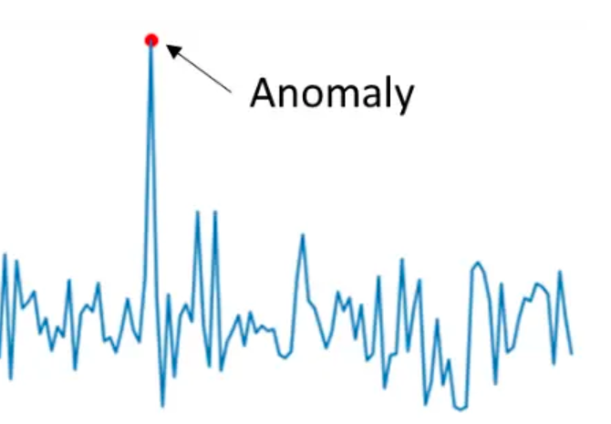
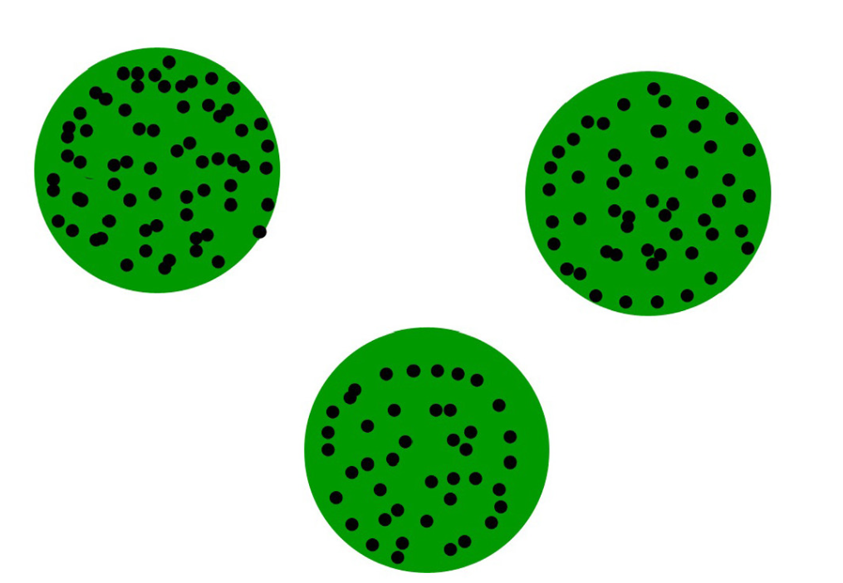
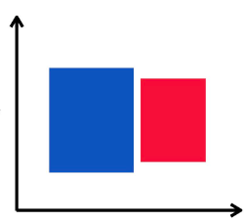
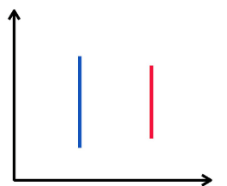
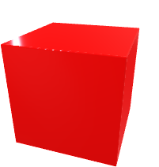
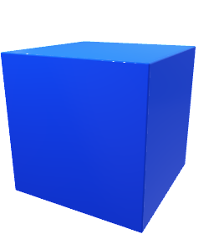
Unsupervised Learning
Clustering
Anomaly Detection
Dimensionality Reduction
Notes:
Let’s now talk about Unsupervised Learning — where the machine learns without any labeled data.
So far, we’ve talked about supervised learning, where we give the model both the inputs and the correct outputs (labels).
But what if we don’t have any labels?
In unsupervised learning, we only give the model the input data — and ask it to find patterns or structure on its own.
There are three common types of unsupervised learning tasks:
🔵 Clustering
Clustering is like grouping things that are similar.
Imagine giving the algorithm a bunch of data points — with no labels — and asking it:
➡️ “Can you organize these into natural groups?”
Example: A company wants to group customers based on their shopping behavior — without knowing in advance who’s who. The algorithm might find 3 clusters like in the image:
One group prefers electronics
One likes sports gear
Another prefers books
This is useful for marketing, recommendations, and personalization.
🔍 Anomaly Detection
Here, we’re looking for things that don’t fit the pattern — the outliers.
In the chart, the model sees regular behavior most of the time, but then suddenly, something very different happens — that spike is the anomaly.
Example: Detecting fraud in credit card usage, or errors in sensor data.
Even though there are no labels, the model learns what “normal” looks like — and flags anything unusual.
📉 Dimensionality Reduction
Sometimes, our data has too many features — it’s hard to work with or visualize.
Dimensionality reduction helps us simplify the data by reducing the number of variables, while still keeping the important information.
In the chart, a complex 3D dataset is reduced to 2D — and you can still see the key differences between the red and blue groups.
This is useful for:
Visualizing high-dimensional data
Speeding up learning
Removing noise from datasets

Slide 30







$$x_{2}$$
$$x_{2}$$
age
age
$$x_{1}$$
$$x_{1}$$
$$Tumor size$$
$$Tumor size$$
Supervised learning
Learn from data labeled
with the ‘right answer’
Unsupervised learning
Find something interesting unlabeled data
Notes:
🧠 Supervised vs Unsupervised Learning
Let’s compare these two big ideas in machine learning.
🔴 On the left: Supervised Learning
Here, we have data with labels — we already know the answers.
In this example, each point represents a tumor, and we know whether it’s benign (blue star) or malignant (green triangle).
We train a model to learn from these labeled examples.
The model then draws a decision boundary (the yellow line) that separates the two classes.
Later, when we see a new tumor, the model can use this boundary to predict whether it’s benign or malignant.
🟠 On the right: Unsupervised Learning
Now, we don’t have any labels. We just have a bunch of data points.
The model doesn’t know what “benign” or “malignant” means — but it can still look for patterns or groupings.
In this case, it has clustered the points into two groups, based only on how similar they are.
We might look at these groups later and realize:
One group might be benign, and the other malignant!"

Slide 31
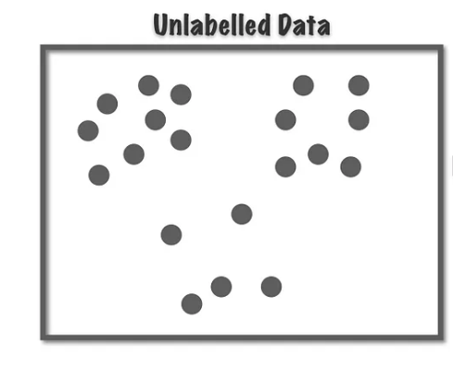
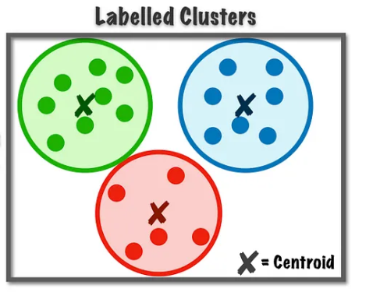
Clustering
Notes:
Clustering is a method in unsupervised learning where we group similar data points based on their shared characteristics, without having predefined labels or categories. Imagine you're running a retail company with customer data like purchase history, age, income, and shopping behavior. Using clustering algorithms, such as K-means or hierarchical clustering, you can segment your customers into meaningful groups like 'Frequent Shoppers,' 'Seasonal Shoppers,' or 'Online Shoppers.' The process involves measuring similarity (e.g., using Euclidean distance) between data points and assigning them to clusters based on this similarity. For instance, K-means partitions the data into a specific number of clusters you define, while hierarchical clustering builds a tree-like structure to reveal natural groupings. By identifying these patterns, you can tailor your marketing strategies to different customer groups more effectively, boosting customer satisfaction and sales.

Slide 32
What is unsupervised learning, and how does it differ from supervised learning?
A) Unsupervised learning involves training a model with labeled data, while supervised learning uses unlabeled data.
B) Unsupervised learning is used for classification tasks, whereas supervised learning is used for clustering.
C) Unsupervised learning deals with unlabeled data and seeks to find patterns or structures within the data without explicit target labels.
D) Unsupervised learning requires more computational resources compared to supervised learning.
Notes:
c

Slide 33
Which of the following is typically NOT a common application of unsupervised learning?
A) Customer segmentation in marketing
B) Handwriting recognition
C) Anomaly detection in cybersecurity
D) Image compression
Notes:
A) Customer segmentation in marketing: This is a common application of unsupervised learning where customer data is clustered into groups based on their purchasing behavior, demographics, or other features to tailor marketing strategies.
B) Handwriting recognition: Handwriting recognition is typically a supervised learning task where a model is trained on labeled data (handwritten characters with corresponding labels) to recognize and classify handwritten text.
C) Anomaly detection in cybersecurity: Unsupervised learning is often used for anomaly detection where the algorithm learns the normal behavior of a system and flags instances that deviate significantly from this norm as potential anomalies or threats.
D) Image compression: Unsupervised learning can be used for image compression, where the algorithm identifies patterns and redundancies in an image and represents it more efficiently. Techniques like Principal Component Analysis (PCA) can be employed for dimensionality reduction in image data.
So, the correct answer is B) Handwriting recognition because it typically involves supervised learning, not unsupervised learning.

Slide 34
Linear Regression Model
Linear regression
500
400
Price
300
200
100
0
1000
2000
3000
House size
Regression model predicts numbers
Classification model predicts categories
Notes:
"Alright everyone, let’s go a bit deeper into regression. I’m sure some of you remember this example — house prices and sizes. Let’s take another look.
So, we’re talking about linear regression — probably one of the most widely used algorithms in machine learning. Why? Because it’s simple and powerful. Basically, we’re just trying to fit a straight line to our data. That line helps us predict something.
Now look at the graph. Each blue star is a house. On the x-axis we have the house size, and on the y-axis we have the price. You can think of it like this:
'If I know the size of a house, can I guess how much it will cost?'
That’s exactly what linear regression does.
Let’s say you want to estimate the price of a house that’s 2000 square feet. You just go to 2000 on the x-axis, move up to the red line, and check the y-axis.
➡️ It tells you the price is somewhere between 300 and 400 thousand dollars.
Pretty cool, right? You’re predicting a number — a continuous value.
Now let’s pause for a second and compare this with classification.
In classification, you don’t predict a number — you predict a category. For example:
Is this tumor benign or malignant?
Is this email spam or not spam?
So here’s the difference:
Regression = predicting numbers (like price, temperature)
Classification = predicting categories (like labels, types)
Simple rule:
🎯 If your output is a number → use regression
🏷️ If your output is a class or label → use classification
Make sense?"

Slide 35
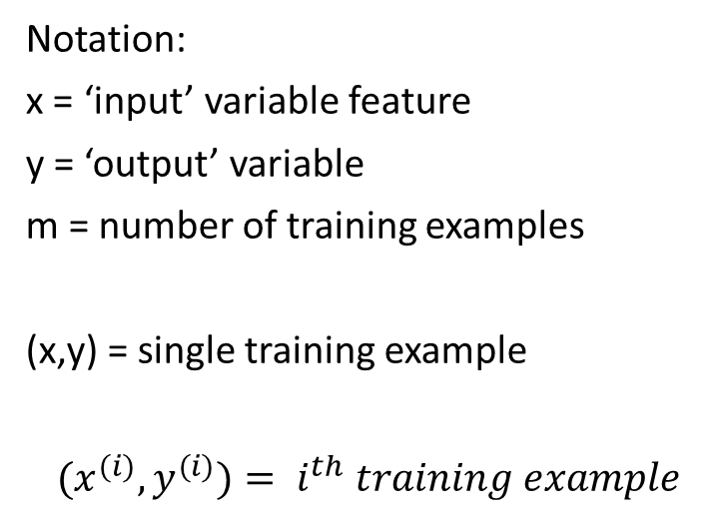
Terminology
x | y
Size(feet^2) | Price
(1) 2104 | 460
(2) 1416 | 232
(3) 1534 | 315
(4) 852 | 178
… | …
(47) 3210 | 870
Notation:
x = ‘input’ variable feature
y = ‘output’ variable
m = number of training examples
(x,y) = single training example
$${(x}^{(i)},y^{(i)})= i^{th} training example$$
Notes:
Okay everyone, before we go deeper into the math of linear regression, let’s pause and make sure we understand the basic terms. These will come up again and again, so it’s important that we’re all on the same page.
🔤 Terminology Time!
We’re working with a dataset — here, it’s a table showing house sizes and their corresponding prices.
x is the input — in this case, the size of the house, measured in square feet.
y is the output — the price of the house, in thousands of dollars.
Each row in the table is one training example — basically, one house.
Let’s look at the first one:
House size = 2104 square feet,
Price = 460 thousand dollars
So, this example is written as a pair: x = 2104, y = 460.
✏️ Notation Breakdown:
m is the total number of training examples — here, we have 47 houses, so m = 47.
(x, y) is a single training example.
If we want to talk about the i-th example in the dataset, we write it like this:
(x^{(i)}, y^{(i)})
That just means: “The i-th house and its price.”
So for example:
(x(3),y(3))=(1534,315)
🧠 Why is this important? Because when we build a model, we’re going to loop through all these examples — and we need to understand what each piece means. So this notation helps us write the algorithm clearly and consistently.

Slide 36

Training set
Learning Algorithm
f
$$\hat{y}$$
x
How to represent f?
$$f_{\overline{w},b}\left(\overline{x}\right)=wx+b$$
y
Linear regression with one variable
Univariate linear regression
x
Notes:
"Let’s talk about how supervised learning works — and we’ll break it down step by step.
So, imagine you have a training set. That means we’re giving the model two things:
Inputs — for example, the size of a house
Outputs — like the actual price of that house
These outputs are what we call the right answers — they’re what the model is trying to learn to predict.
🧠 Now here’s the idea:
We give both the inputs and outputs to a learning algorithm. This algorithm tries to find a pattern — a rule — that connects the two.
In machine learning, we often call this rule a function, and we write it as a little f.
So we say:
Y_hat= f(x) This just means: “the prediction y-hat is the result of applying f to the input x.”
We call f our model. It takes an input (like house size) and gives us an output (a predicted price).
📏 But how do we represent this function f?
In this example, we’re using a line, because it’s simple and easy to understand.
So the function looks like this:
f(x)=w⋅x+ b
w is the weight — how strongly x affects the output
b is the bias — the starting point (where the line crosses the y-axis)
This is what we call linear regression with one variable, or univariate linear regression.
🌀 Sometimes a straight line isn’t enough. If the data doesn’t follow a nice linear trend, we might use:
More complex functions
Curves or even deep models
That way, we can capture the real pattern in the data more accurately.

Slide 37
Cost Function
3
y
2
$$f_{\overline{w},b}\left(\overline{x}\right)=wx+b$$
1
0
1
2
3
0
x
3
3
3
f(x) = 0*x + 1.5
f(x) = 0.5*x
f(x) = 0.5*x + 1
2
2
2
1
1
1
0
0
0
0
1
2
3
0
1
2
3
0
1
2
3
w = 0
b = 1.5
w = 0.5
b = 0
w = 0.5
b = 1
Notes:
"Okay class, now that we know our model is trying to learn a function like
f(x)=wx+b,
, the big question is:
👉 How do we know if our model is doing a good job?
This is where the cost function comes in.
💰 What is a Cost Function?
The cost function tells us how far off our model’s predictions are from the actual data.
It measures the error — how wrong the model is — for a particular set of parameters, like w and b.
Let’s look at these three examples in the slide
🔹 First graph:
The function is: f(x) = 0*x + 1.5
That means it's just a flat horizontal line at 1.5.
It doesn’t really match the data, right?
So, the cost is high here.
🔹 Second graph:
Now we try f(x) = 0.5*x.
It starts to move in the right direction — it’s sloped.
Still not perfect, but better. The cost is lower than before.
🔹 Third graph:
f(x) = 0.5*x + 1
This line fits the data much better.
Predictions are closer to the actual values, so the cost goes down even more.
🧠 So what's the goal of our learning algorithm?
✔️ Try different w and b values
✔️ Calculate the cost each time
✔️ Find the values that give us the lowest cost
That’s how we train a model — by finding the best-fitting line with the smallest possible error.
The most common cost function we use in linear regression is called Mean Squared Error (MSE).
It just means:
“Take the difference between predicted and actual values, square them, and average the result.”

Slide 38
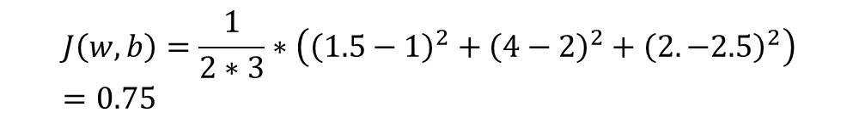

$$f_{\overline{w},b}\left(\overline{x}\right)=wx+b$$
y
$$J\left(w,b\right)=\frac{1}{2m}\sum_{i=1}^{m}{({\hat{y}}^{(i)}}{−y^{\left(i\right)})}^{2}$$
x
f(x) = 0.5*x + 1
4
2
1
$$J\left(w,b\right)=\frac{1}{2∗3}∗\left({\left(1.5−1\right)}^{2}+{\left(4−2\right)}^{2}+{\left(2. −2.5\right)}^{2}\right)=0.75$$
1
2
3
Notes:
Okay everyone, now let’s see how we actually calculate the cost function — this is the part where our model learns from its mistakes.
We’re using a linear model:
f(x)=wx+b
And we want to measure how well it fits our data.
To do that, we use a cost function, which tells us:
❗️How far off are our predictions from the actual values?
🧠 Here’s the formula:
m is the number of examples
ŷ is the predicted value
y is the actual value
We square the difference to make all errors positive, and then average them
This is called Mean Squared Error (MSE) — with a factor of ½ just to make the math cleaner later.
👇 Let’s walk through the example below:
Our model is:
f(x)=0.5x+1f(x) = 0.5x + 1f(x)=0.5x+1 We have 3 data points:
When x = 1, the true value y = 1
When x = 2, y = 4
When x = 3, y = 2
Let’s compute the predictions:
f(1) = 1.5
f(2) = 2
f(3) = 2.5
Now let’s compute the squared errors:
(1.5 - 1)^2 = 0.25
(2 - 4)^2 = 4
(2.5 - 2)^2 = 0.25
So the total cost becomes:
J(w,b)=0.75💡 What does this mean?
This cost value — 0.75 — tells us how good or bad our model is.
The lower the cost, the better our line fits the data.

Slide 39
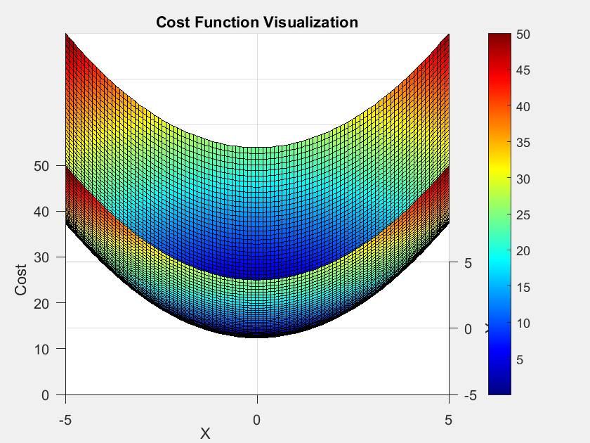
Visual of Cost Function
Notes:
now let’s visualize what we’ve been talking about.
This is a 3D plot of the cost function — it shows how the cost changes depending on the values of w (the slope) and b (the intercept).
🧠 Let’s break it down:
The horizontal axes (X and Y) represent different values of the model parameters w and b.
The vertical axis shows the cost — how wrong our model is with those specific parameter values.
Each point on this surface tells us:
'If I use this particular w and b, what’s the cost I get?'
🕳️ As you can see, the shape of the surface looks like a bowl.
The sides are high — that’s where the cost is large
The bottom of the bowl — that’s the lowest cost → the best combination of w and b
That’s exactly what our algorithm is trying to find.
❓But how do we find that minimum point?
We could try every possible combination manually…
🤔 But that would take forever — especially with more dimensions.
Instead, we use a smarter method called:
🔽 Gradient Descent
It’s an optimization algorithm that takes small steps downhill — always moving toward lower and lower cost — until it reaches the bottom.

Slide 40


Gradient Descent
OUTLINE:
  Initialization: We start with some initial parameter values.
  Calculate Gradient: We calculate the gradient of the loss function with respect to each parameter. This gradient points in the direction of the steepest increase in the loss.
  Update Parameters: We adjust the parameters by a small amount in the opposite direction of the gradient. This helps us move closer to the parameter values that minimize the loss.
  Repeat: We repeat steps 2 and 3 iteratively, each time moving a bit closer to the minimum of the loss function.
$$J(w)$$
$$w$$
Notes:
Lets mention what is gradient descent and how it is work more
Gradient Descent is a method we use to help our model improve by reducing the error step by step. We start by picking some initial values for our parameters (like w and b), then we calculate the gradient — It tells us in which direction the error increases the most. But instead of going that way, we move in the opposite direction — toward where the error decreases. We update the parameters a little bit, and then repeat the process again and again. With each step, the model gets a little bit better and gets closer to the lowest point — the minimum of the cost function — It means our predictions are getting more accurate.

Slide 41
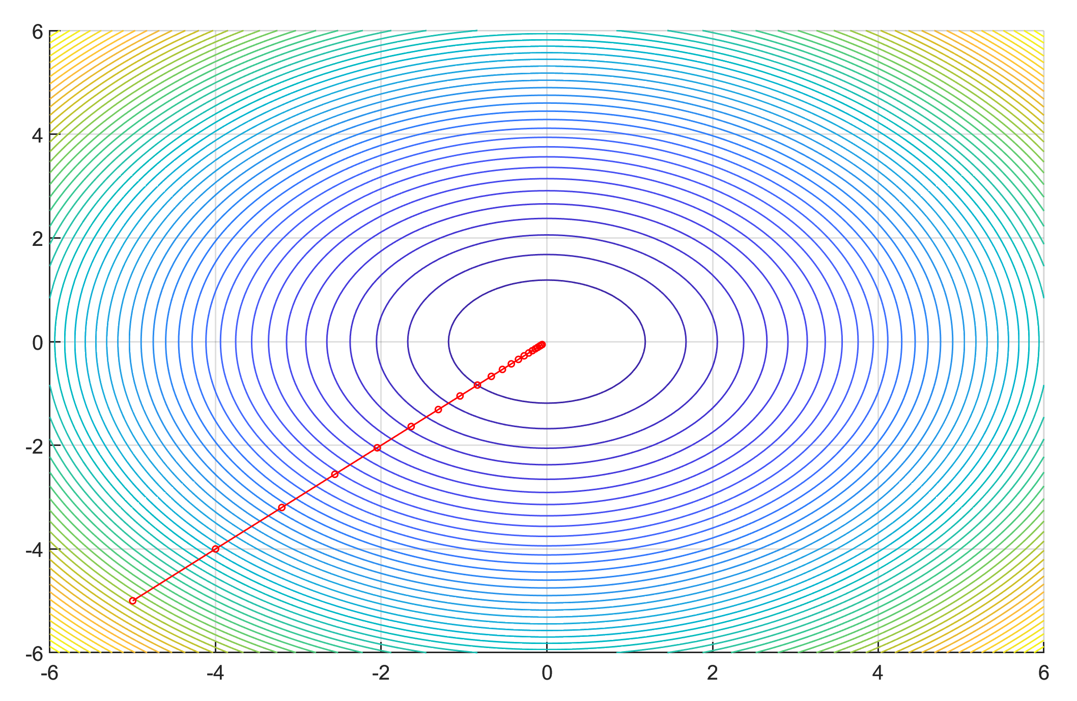
w
b
Notes:
Now imagine we’re looking at the cost function from above, like a map — and this bowl shape shows the cost. The center is the lowest point — that’s the best w and b values for our model.
These circles show levels of cost — kind of like elevation lines on a hiking map.
And that red line you see is the path our model takes as it learns.
At the beginning (down near -5), the steps are big. But as we get closer to the middle, the steps become smaller and smaller — because the model is being careful not to overshoot the minimum.
🧠 This is how gradient descent works:
It starts somewhere random, checks which way is downhill, takes a step, and keeps repeating. Over time, it gets closer and closer to the best spot — the center — where the cost is lowest and the predictions are most accurate."

Slide 42

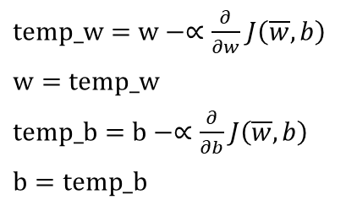
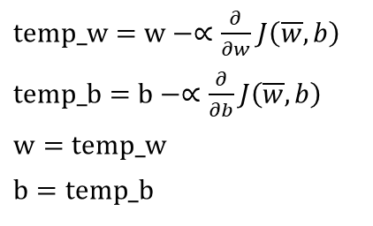

$w_{j}=w_{j} −∝\frac{∂}{∂w_{j}}$ $J\left(\overline{w},b\right)$
Derivative
Learning Rate
$b=b−∝\frac{∂}{∂w_{j}}$ $J\left(\overline{w},b\right)$
Repeat until convergence
Correct: Simultaneous update
Incorrect
$temp_w=w−∝\frac{∂}{∂w}$ $J\left(\overline{w},b\right)$
$temp_b=b−∝\frac{∂}{∂b}$ $J\left(\overline{w},b\right)$
$$w=temp_w$$
$$b=temp_b$$
$temp_w=w−∝\frac{∂}{∂w}$ $J\left(\overline{w},b\right)$
$$w=temp_w$$
$temp_b=b−∝\frac{∂}{∂b}$ $J\left(\overline{w},b\right)$
$$b=temp_b$$
Notes:
Let's take a look at how you can actually implement the gradient descent algorithm. Lets explain the parameter ones more.
𝑤_𝑗: This represents a specific weight in a machine learning model.
α (Alpha): This is the learning rate, generally take small positive number. The learning rate controls the step size in the gradient descent algorithm. It determines how much the weight is updated in each iteration of training.
𝐽(¯𝑤,𝑏): This represents the cost or loss function. The cost function measures how well the model's predictions match the actual target values.
∂/∂𝑤_𝑗: This denotes the partial derivative of the cost function J with respect to the weight 𝑤_𝑗. In simpler terms, it measures how the cost function changes as you make a small change in the weight 𝑤_𝑗. This gradient tells you the direction and magnitude of the steepest ascent of the cost function.
Now, let's put it all together:
We start with an initial set of weights (¯𝑤,𝑏).
We calculate the gradient (∂/∂𝑤_𝑗) 𝐽(¯𝑤,𝑏) for each weight 𝑤_𝑗. This tells us the direction and magnitude to adjust 𝑤_𝑗 to reduce the cost function J.
We multiply the gradient by the learning rate α. This scales the update step to ensure we don't take too large of a step.
We subtract this scaled gradient from the current weight 𝑤_𝑗. This step updates the weight in the direction that reduces the cost function.
By iteratively updating the weights using this formula, the model gradually converges to the set of weights that minimizes the cost function.
And simultineous update is very important you shoud do like first one. İf you do using the second one you will use updated w in b.

Slide 43







$$J(w)$$
$$positive slope$$
$$w$$
$w_{j}=w_{j} −∝\frac{∂}{∂w_{j}}$ $J\left(\overline{w},b\right)$
$$J(w)$$
$$negative slope$$
$$w$$
Notes:
Let’s talk about why gradient descent works — and why we subtract the gradient instead of adding it.
So look at the first graph. The slope is positive — that means if we move to the right, the cost gets worse (goes up). So we don’t want to go that way!
👉 Instead, we move in the opposite direction — to the left — to make the cost go down.
Now look at the second graph. The slope is negative — so the cost goes down when we move right.
👉 Again, we move in the opposite direction of the slope — which now means stepping to the right.

Slide 44
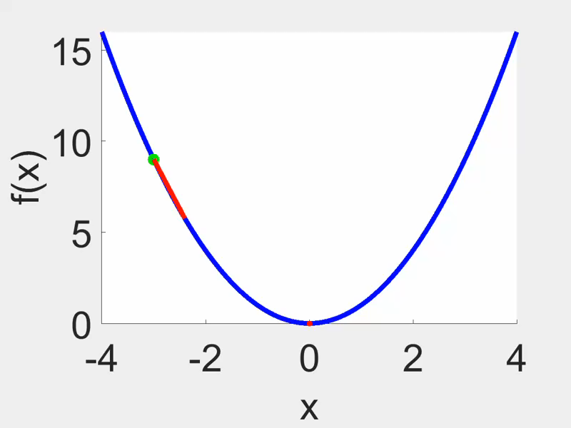
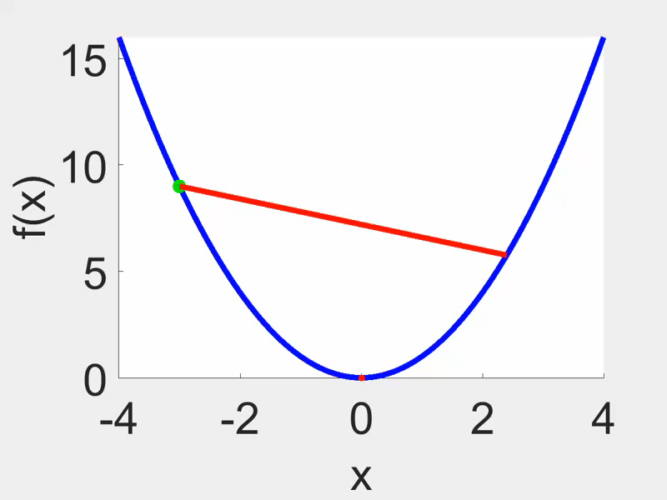

Learning Rate
$w_{j}=w_{j} −∝\frac{∂}{∂w_{j}}$ $J\left(\overline{w},b\right)$
Proper learning rate
Big learning rate
Notes:
Okay, now let’s talk about something really important in training our model — it’s called the learning rate.
Basically, the learning rate decides:
👉 How big of a step we take during each update in gradient descent.
Look at the first graph on the left:
🟢 Here, the step size is just right. The model is making nice, small steps downhill — getting closer to the bottom in a smooth way.
Now look at the second graph on the right:
🔴 The learning rate is too big! The model takes a huge step and jumps across the valley instead of carefully stepping down. It misses the minimum completely — and might even bounce back and forth or never settle.

Slide 45

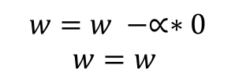



$$J(w)$$
Slope = 0
Local minimum
$$w$$
$$5$$
$$w=w −∝∗0$$
$$w=w$$
$w= w−∝\frac{∂}{∂w}$ $J\left(\overline{w},b\right)$
= 0
Notes:
Let’s zoom in on what happens when gradient descent reaches a local minimum.
So here’s our cost function — it’s not a perfect U shape this time. It’s a bit more wavy, and it actually has two valleys. We call these 'local minima'. That means there might be more than one low point, but only one of them is the absolute lowest — the global minimum.
Now imagine our model has been training and finally lands at the point where w = 5. That’s where we are on this graph — sitting in one of those valleys.
At that point, look at the slope of the curve — it’s flat. The slope is zero, which means the derivative is zero. So if you plug that into the gradient descent formula:
w=w−α⋅0
That just becomes:
w=w
So… nothing changes. The model stops moving. That’s how we know we’ve hit a minimum — because gradient descent has nowhere else to go. It just stays there.
Now the tricky part is:
Sometimes this might be the best possible spot (global minimum),
but other times, it’s just okay, not the best (local minimum)."

Slide 46
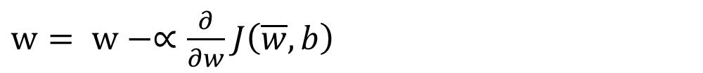
Can reach local minimum with fixed learning rate
$$J(w)$$
$w= w−∝\frac{∂}{∂w}$ $J\left(\overline{w},b\right)$
Large
Not as large
$$w$$
Smaller
Near a local minimum,
Derivative becomes smaller
Uprdate steps become smaller
Notes:
When we look this example we can see different size of arrow. Should Gradient descent step fixed?. Let's have a look at example. The cost function of W that we wish to reduce is shown. let's start the gradient descent algorithm. We may get there if we make only one more update step. Gradient, descent also moves rather far to the right since its derivative is so substantial. At this second stage, we are about to take another step. The slope is not as steep now as it was at the starting position, you can see easly. As a result, the derivative is smaller. Therefore, the following update step won't be as substantial as the previous one. The derivative is now less than it was in the prior phase when you look third one and will move even more slowly as we get closer to the minimum.. when a result, when we descend the gradient, we gradually move in very little steps until we achieve a local minimum. Then our slope will give us a 0 then we can say here is local minima.

Slide 47
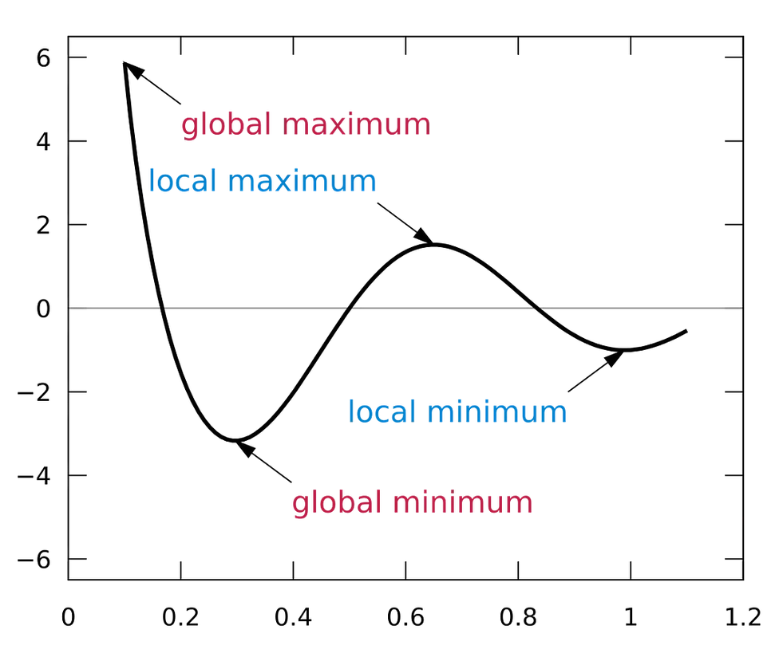
The Curse of Local Minima: How to Escape and Find the Global Minimum
Adding noise
Momentum
Learning rate adjustment
Notes:
Imagine this graph represents the loss function of a machine learning model, where our goal is to minimize the loss. The curve shows various peaks and valleys. A local minimum is a point where the loss is lower than the surrounding points, but it is not the lowest possible value. But, the global minimum is the absolute lowest point on the curve, representing the best possible parameter values for our model.
During optimization, algorithms like Gradient Descent follow the slope of the curve to reduce the loss. However, if the algorithm encounters a local minimum, it might get 'stuck' there, believing it's the lowest point, even though the global minimum is further away. Similarly, local maxima and global maxima represent the highest points on the curve, but they are less relevant here since we're focused on minimizing loss.
To avoid getting stuck in local minima and reach the global minimum, we use techniques like:
Adding noise through Stochastic Gradient Descent to 'shake' the algorithm out of local minima.
Momentum, which helps carry the optimization forward through small dips.
Learning rate adjustment, where a larger learning rate in the beginning allows exploration, followed by a smaller learning rate for fine-tuning.

Slide 48
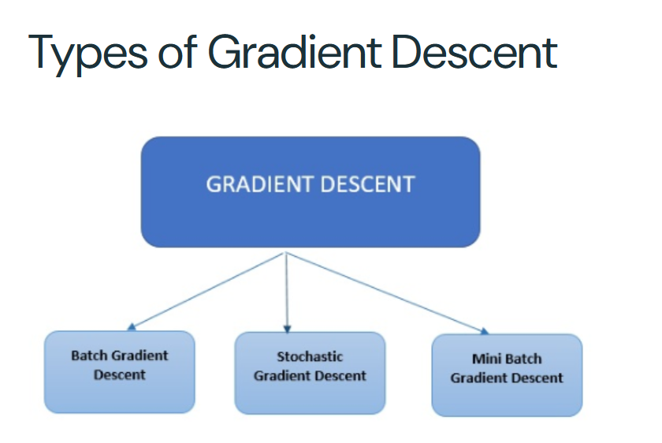
Notes:
There are three primary types of gradient descent used in modern machine learning and deep learning algorithms.

Slide 49
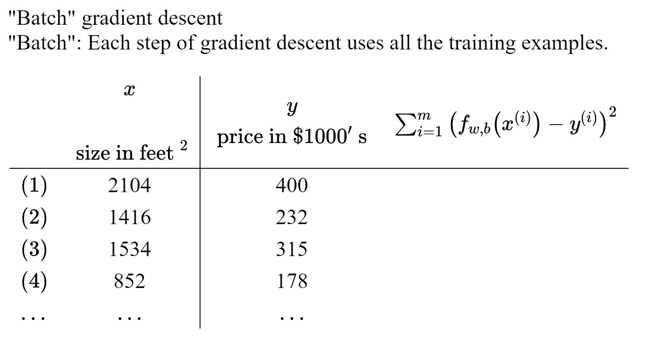
Batch Gradient Descent
Notes:
As we’ve discussed earlier, gradient descent is an optimization algorithm used to minimize the cost function by updating the model’s parameters iteratively. It helps find the best-fit line or boundary that makes predictions as accurate as possible.
Batch Gradient Descent is one of the variations of gradient descent. It calculates the gradient of the cost function using the entire dataset at each step of the optimization process
Challenges of Batch Gradient Descent
"While precise, batch gradient descent can be computationally expensive, especially for large datasets. Since it requires loading the entire dataset into memory, it might not be feasible for very large datasets.«

Slide 50
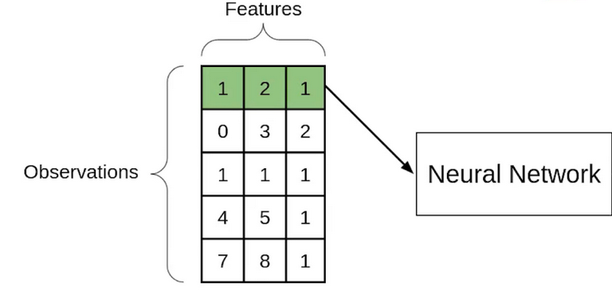
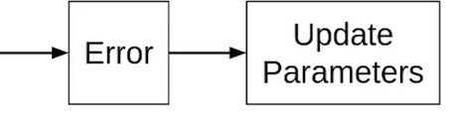
Stochastic Gradient Descent(SGD)
Notes:
If you use a single observation to calculate the cost function it is known as Stochastic Gradient Descent, commonly abbreviated as SGD. We pass a single observation at a time, calculate the cost and update the parameters.
Let’s say we have 5 observations and each observation has three features and the values that I’ve taken are completely random.
Then will take the second observation and perform similar steps with it. This step will be repeated until all observations have been passed through the network and the parameters have been updated.

Slide 51
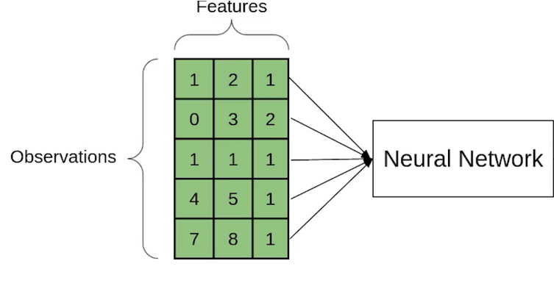
Stochastic Gradient Descent(SGD)
Notes:
Each time the parameter is updated, it is known as an Iteration. Here since we have 5 observations, the parameters will be updated 5 times or we can say that there will be 5 iterations. Had this been the Batch Gradient Descent we would have passed all the observations together and the parameters have been updated only once. In the case of SGD, there will be ‘m’ iterations per epoch, where ‘m’ is the number of observations in a dataset.
So far we’ve seen that if we use the entire dataset to calculate the cost function, it is known as Batch Gradient Descent and if use a single observation to calculate the cost it is known as SGD.

Slide 52
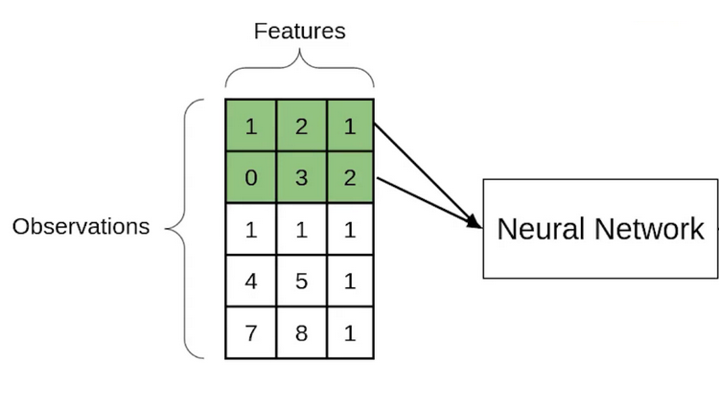
Mini-batch Gradient Descent
Notes:
Another type of Gradient Descent is the Mini-batch Gradient Descent. It takes a subset of the entire dataset to calculate the cost function. Imagine you have a dataset with 800 observations, and you’re using Mini-Batch Gradient Descent with a batch size of 32. Instead of processing all 800 observations at once (like Batch Gradient Descent) or one at a time (like Stochastic Gradient Descent), Mini-Batch Gradient Descent splits the dataset into smaller groups called mini-batches. In this case, 800 observations will be divided into 25 mini-batches (since 800/32=25). Each mini-batch, containing 32 observations, is processed in a single iteration: the model predicts outputs for those 32 observations, calculates the loss, computes gradients, and updates the parameters. For example, in the first iteration, the algorithm uses data points 1–32 to update weights and biases; in the next iteration, it uses data points 33–64, and so on, until all 25 mini-batches are processed, completing 1 epoch. This approach balances speed and stability, making it efficient for large datasets while avoiding the noisiness of Stochastic Gradient Descent.

Slide 53
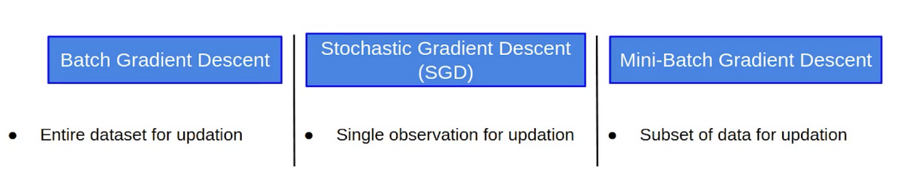
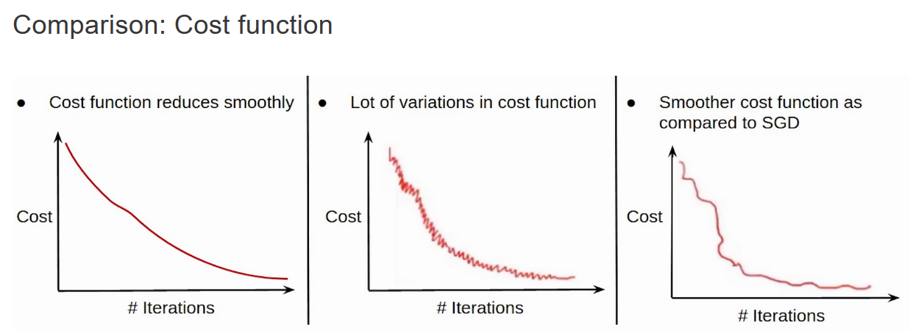
SUMMARY
Notes:
To wrap up today's topic, we explored the three main types of Gradient Descent: Batch, Stochastic (SGD), and Mini-Batch. Batch Gradient Descent uses the entire dataset to update the model, resulting in smooth but sometimes slow progress. SGD updates the model using just one data point at a time — it’s faster but introduces a lot of noise and variation in the cost function. Mini-Batch strikes a balance by using small groups of data, giving us faster updates with less noise than SGD. As shown in the graphs, each method impacts how smoothly or quickly the cost function decreases over time. Great work understanding the differences — we’ll see how to apply these techniques in practice next! 🚀

Slide 54

Q&A

Slide 55


Create Account
Create repository
https://www.youtube.com/watch?v=HW29067qVWk
https://www.youtube.com/watch?v=iv8rSLsi1xo

